Slide 1
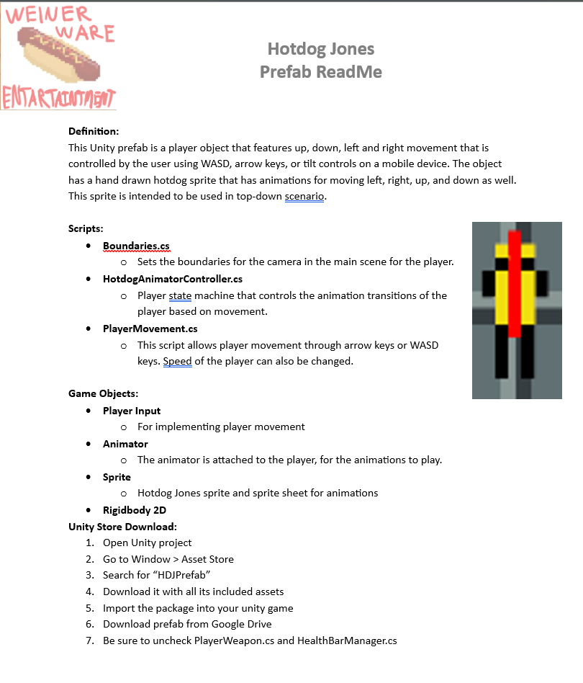
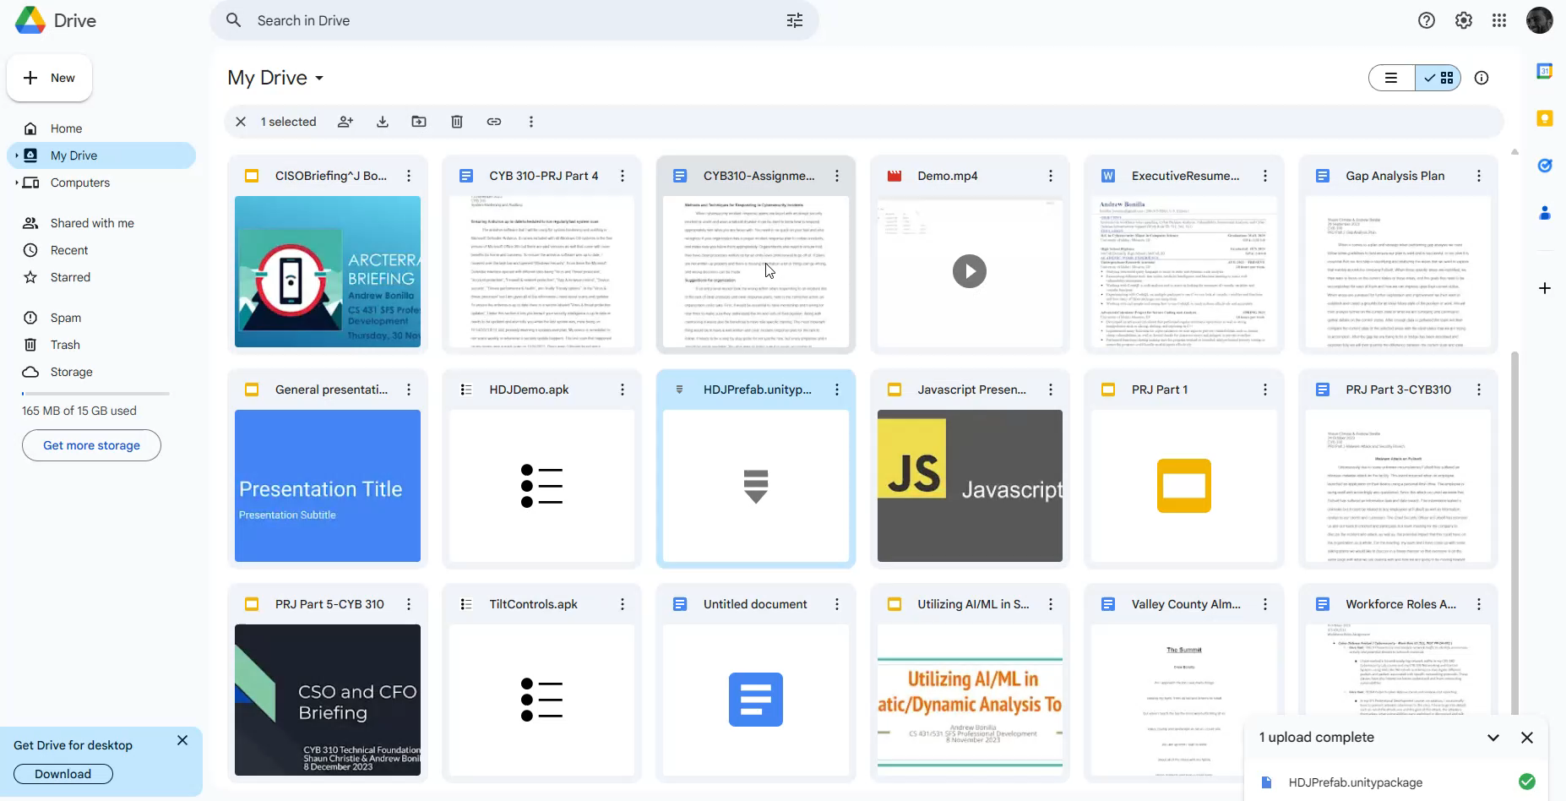
https://drive.google.com/file/d/1W6XN77pE9Zv2lf6IYi71R5momru2BVT6/view?usp=drive_link

